Slide 1
BCA Mobile App Redesign
Miguel Roland Jonathan – IS Major

Slide 2
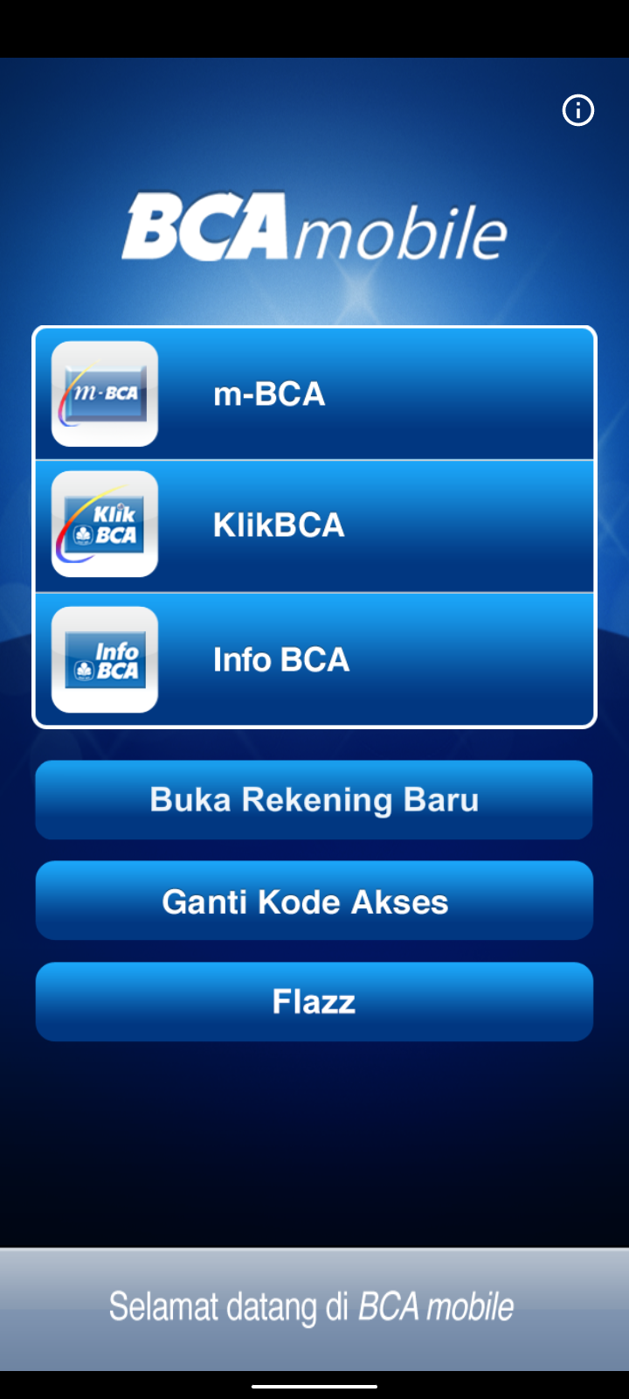
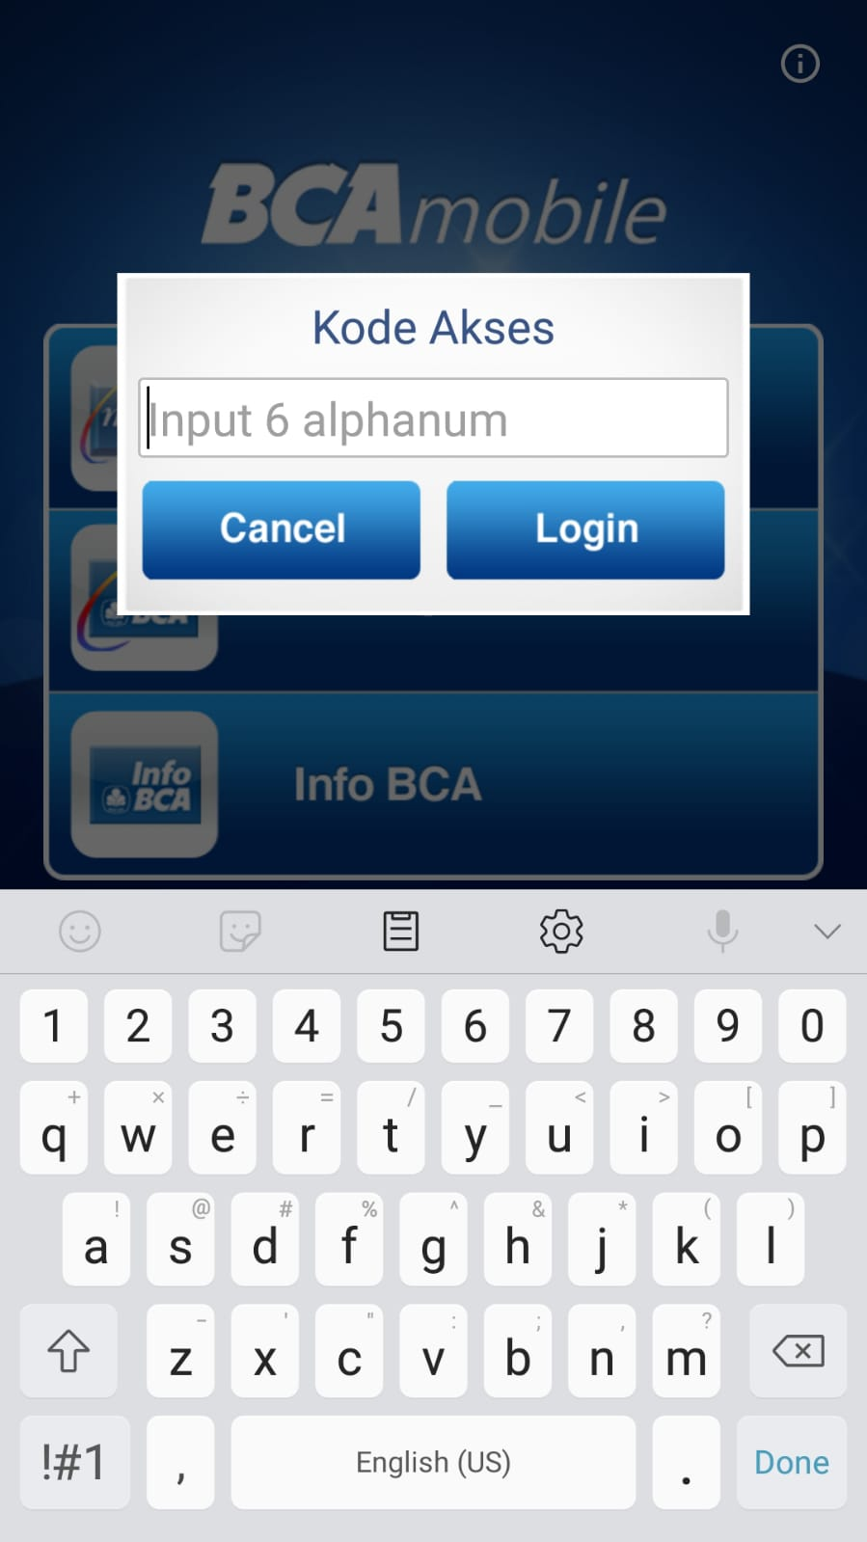
Why BCA Mobile App Redesign?
c
Outdated design
c
Annoying required pop-up that should be filled

Slide 3
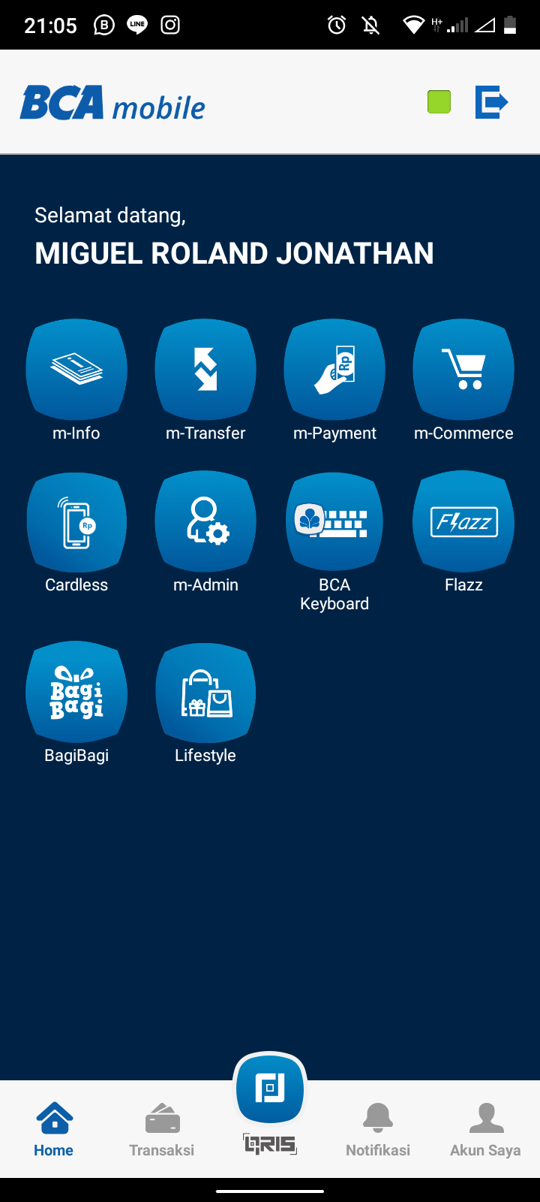
Why BCA Mobile App Redesign?
c
Annoying loading time when waiting for the green light
Cramped up UI, discouraging people to explore other functions from m-BCA

Slide 4
What do I aim to fix?
01
03
05
02
04
06
Design
Focus Point
Refined UX
Simplified, modern, and more engaging UI
Giving the customer a shortcut for their convenience
User’s usual needs is displayed with easy access
Time Consumed
All-in-one
Functional
Reduce the click amount needed to do an action
Include more feature in one page
Keep the old system that still works flawlessly

Slide 5
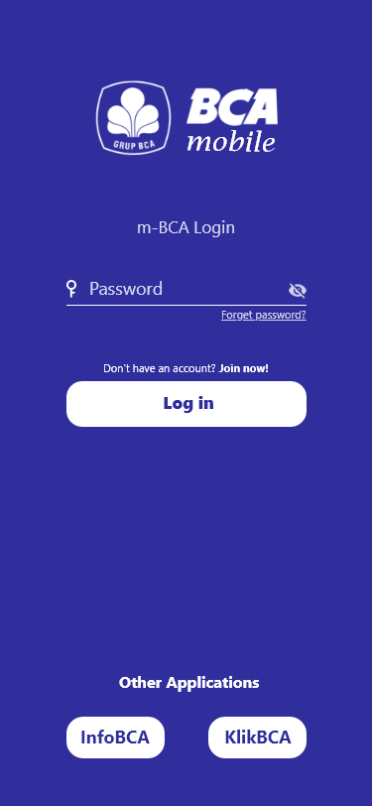
c
Changes
made
c
Simplified UI to open m-BCA
Can still directly access two other BCA apps

Slide 6
Changes made
Removed unnecessary steps

Slide 7

Changes made
Green light button changed into loading screen

Slide 8
System Flow Overview
Details will be explained later

Slide 9
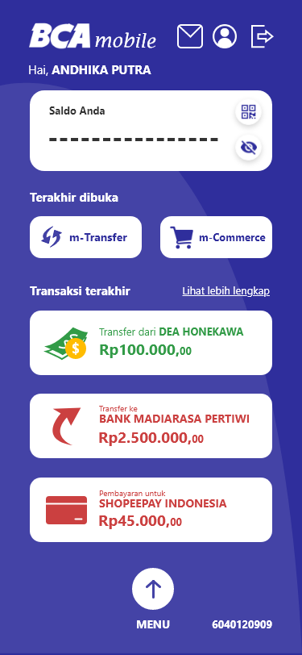

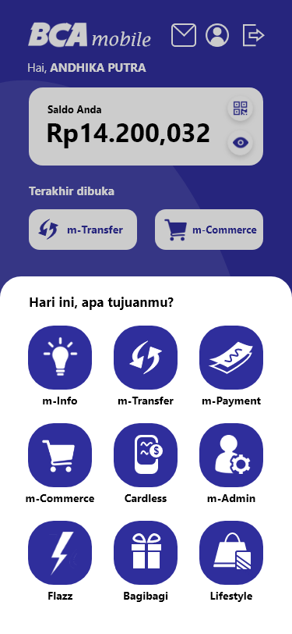
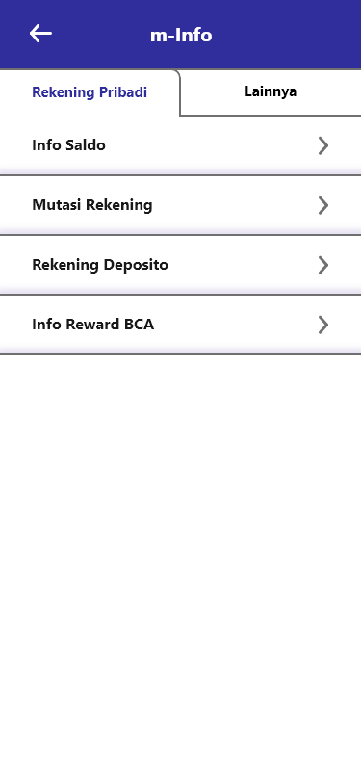
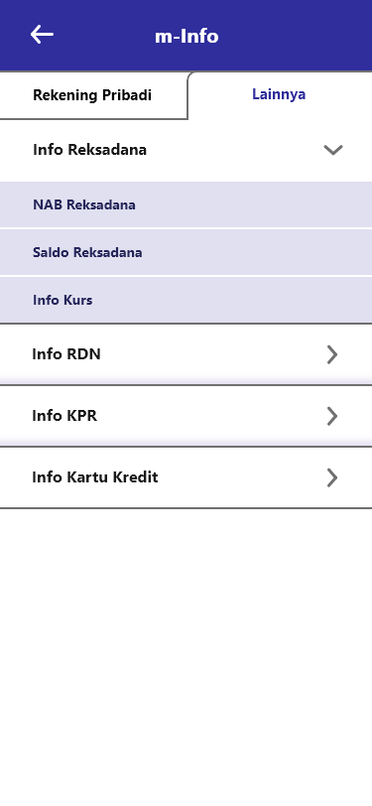

Slide 10
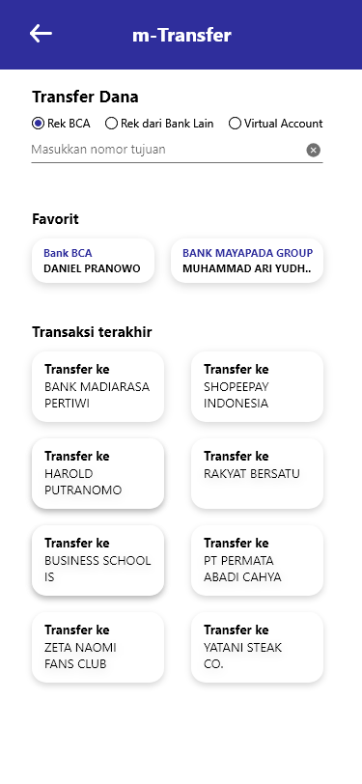
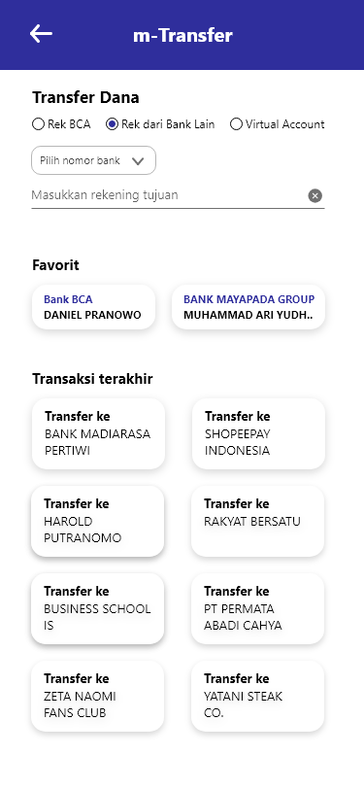
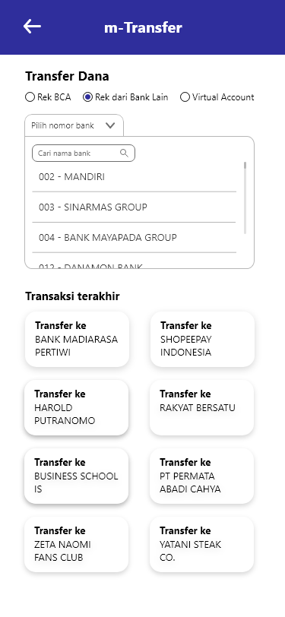
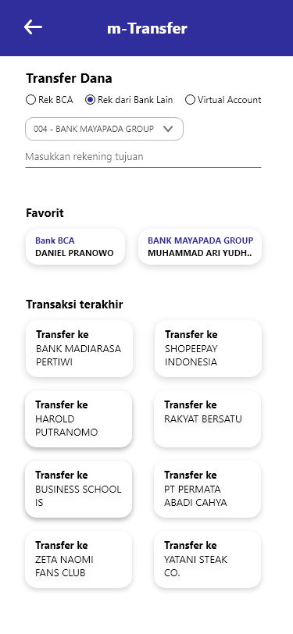

Slide 11
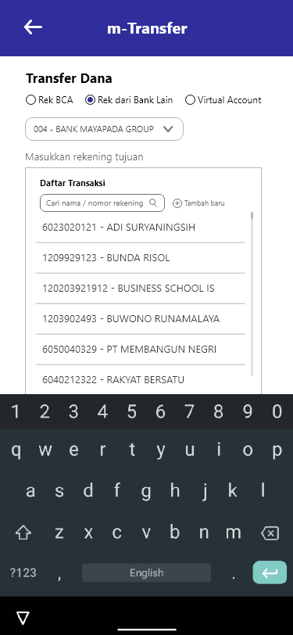
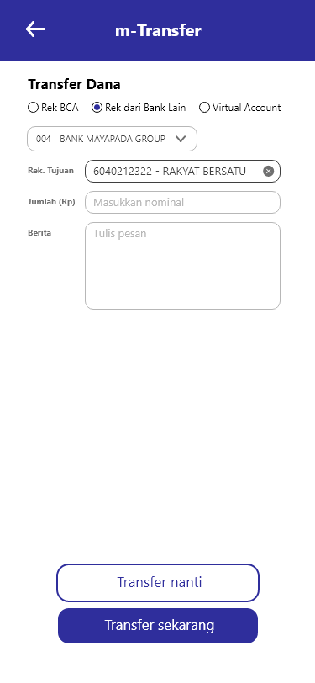
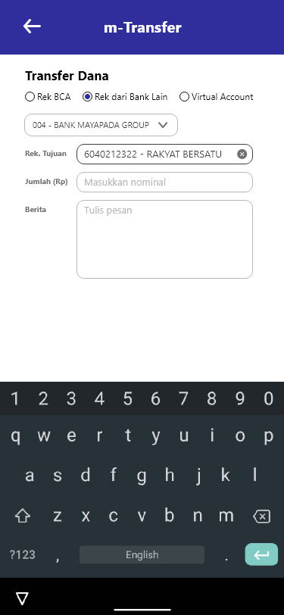
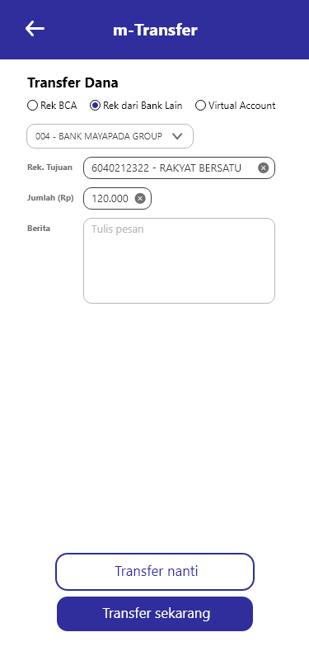
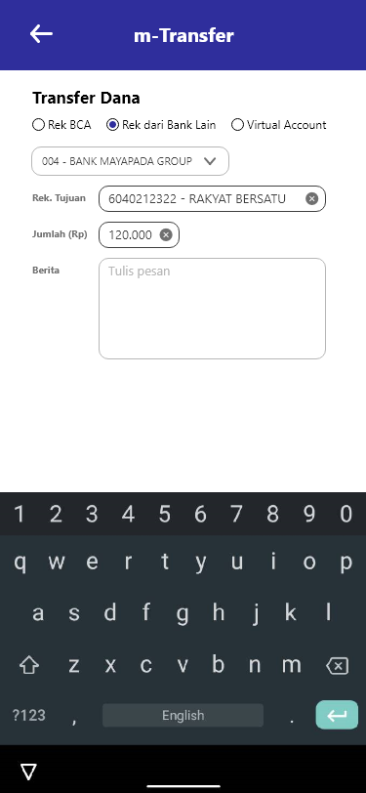
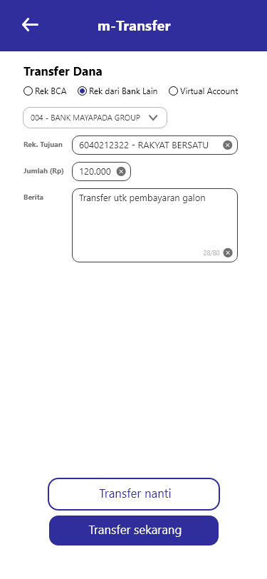
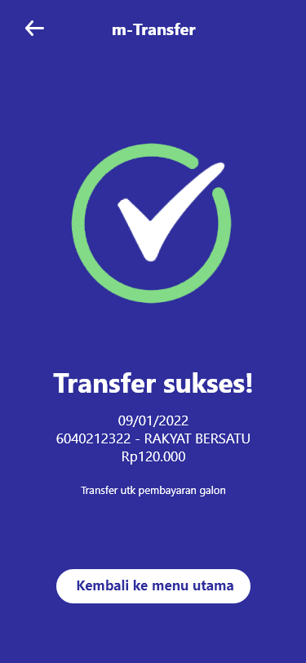
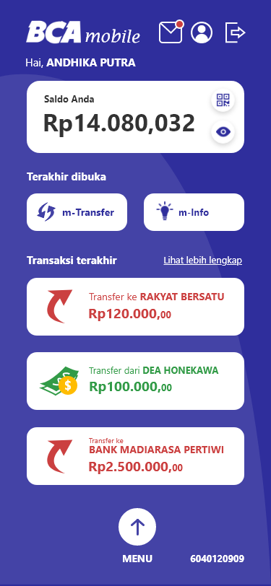

Slide 12
Explanation

Slide 13
Overview
User type in their password
User press
login button
*bolded text means it is clicked in this demo

Slide 14
Overview
This is the Homepage
User can choose to instantly see their balance safely
User have a shortcut to features they recently used
User can check their transfer history quickly
User can track records on their most recent transaction result easily
*bolded text means it is clicked in this demo

Slide 15
Overview
User can see their balance quickly and safely
User clicks the menu bar
*bolded text means it is clicked in this demo

Slide 16
Overview
User can see all BCA menu in the menu bar
User clicks m-Info menu
*bolded text means it is clicked in this demo

Slide 17
Overview
User can see the menu is sorted neatly
User clicks ‘Lainnya’ tab
*bolded text means it is clicked in this demo

Slide 18
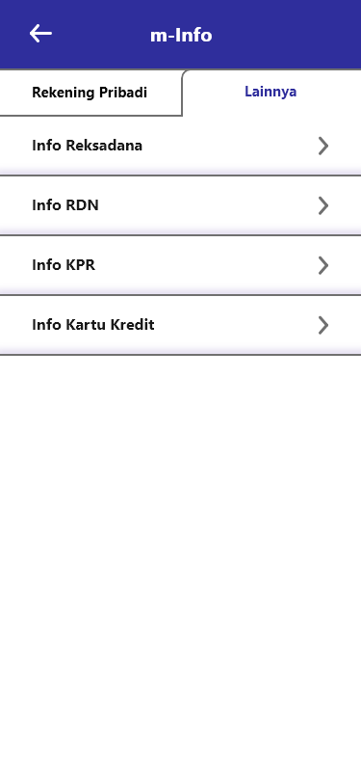
Overview
The tab is changed, and the function is sorted neatly
User clicks the next button
*bolded text means it is clicked in this demo

Slide 19
Overview
The sub-function is shown on a lists, the list will be keep shown even after the user restart the apps.
User press ‘back’ button
*bolded text means it is clicked in this demo

Slide 20
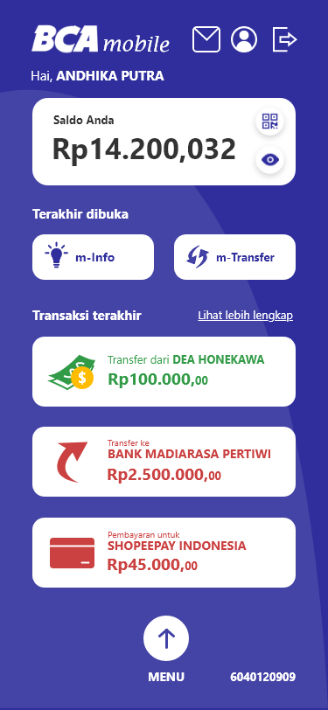
Overview
The recently opened tabs is now updated
*bolded text means it is clicked in this demo

Slide 21
Now, let’s test our apps efficiency (how many clicks it takes to do a function)
We’ll try to make a transfer to RAKYAT BERSATU account

Slide 22
Transfer steps
Clicks: 0
Let’s start from homepage!

Slide 23
Transfer steps
Clicks: 1
User access their recently opened tabs to access m-Transfer function
*bolded text means it is clicked in this demo

Slide 24
Transfer steps
Clicks: 2
User are able to choose their number to transfer, and they can also quickly transfer to their favorite number and latest transaction
User press their latest transaction button
*bolded text means it is clicked in this demo

Slide 25
Transfer steps
Clicks: 3
Input from user:
- Transfer account
- Transfer amount
- Notes on transfer (optional)
*bolded text means it is clicked in this demo

Slide 26
Transfer steps
Clicks: 4
User can choose to transfer now or later (BCA features)
User press ‘Transfer
sekarang’ button
*bolded text means it is clicked in this demo

Slide 27
Transfer steps
Clicks: 4
And…
it’s done!
The page is changed to a more-focused UI for better experience
*bolded text means it is clicked in this demo

Slide 28
Only in 4 clicks, the transfer is done!
It’s faster and more efficient than the old m-BCA, which from my experience usually needs around 10 clicks

Slide 29
Overview
New notification of the successful transaction
Updated ‘recently opened’ menu bar
Updated ‘recent transaction’ menu bar

Slide 30


